Slide 1
Computer Vision
Part 3: Generative Adversarial Network
ADF

Slide 2

Agenda
Part 1: Deep Dream and Style Transfer
Part 2: Variational AutoEncoder
Part 3: Generative Adversarial Network
Computer Vision

Slide 3
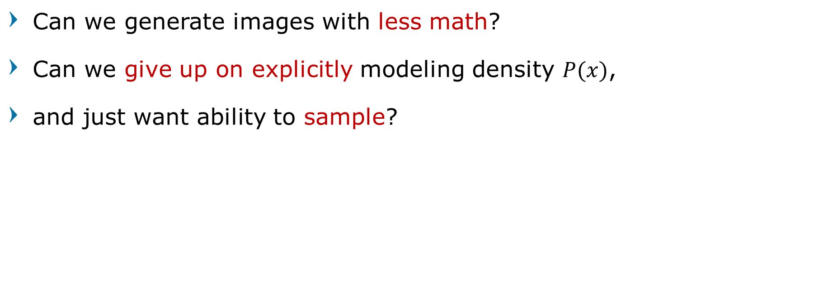
Easy way Generating Image?
Can we generate images with less math?
Can we give up on explicitly modeling density $P(x)$,
and just want ability to sample?
Computer Vision

Slide 4
Easy way Generating Image?
Want to sample from complex, high-dimensional training distribution.
No direct way to do this!
Computer Vision

Slide 5
Generative Adversarial Networks
Computer Vision

Slide 6
Generative Adversarial Networks
Sample from a simple distribution, e.g. random noise.
Learn transformation to training distribution
Don’t have to work with any explicit density function!
Instead, take game-theoretic approach: learn to generate from training distribution through 2-player game
Computer Vision

Slide 7
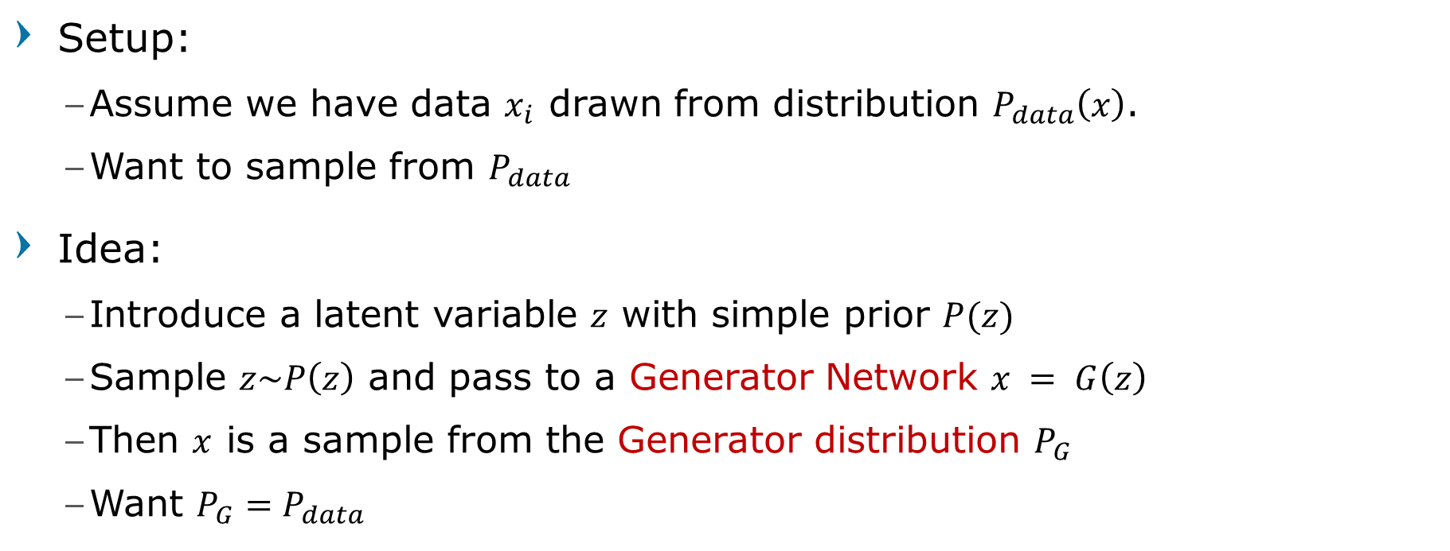
Training GANs: Two-player game
Setup:
Assume we have data $x_{i}$ drawn from distribution $P_{data}\left(x\right)$.
Want to sample from $P_{data}$
Idea:
Introduce a latent variable $z$ with simple prior $P(z)$
Sample $z\sim P\left(z\right)$ and pass to a Generator Network $x = G\left(z\right)$
Then $x$ is a sample from the Generator distribution $P_{G}$
Want $P_{G}=P_{data}$
Goodfellow et al, “Generative Adversarial Nets”, NIPS 2014
Computer Vision

Slide 8
Training GANs: Two-player game
Generator network:
try to fool the discriminator by generating real-looking images
Convert z into fake data x
Discriminator network:
try to distinguish between real and fake images
Real examples (1): from dataset
Fake examples (0): from generator
Goodfellow et al, “Generative Adversarial Nets”, NIPS 2014
Computer Vision

Slide 9
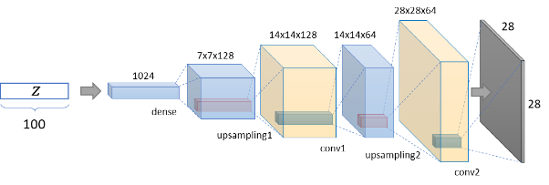
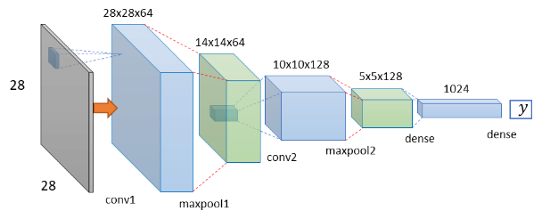
Training GANs: Two-player game
Generator network:
Convolutional Decoder
Vector input, output image volume
Discriminator network:
Binary classifier
Volume image input, output binary
Computer Vision

Slide 10
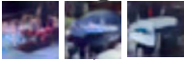
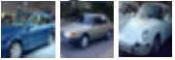
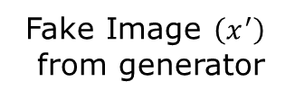
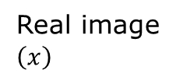
Generative Adversarial Networks
Real or Fake?
y
Discriminator Network (binary classification)
Fake Image $\left(x^{′}\right)$
from generator
Real image
$\left(x\right)$
Generator Network (decoder)
Random Noise
z
Goodfellow et al, “Generative Adversarial Nets”, NIPS 2014
Computer Vision

Slide 11
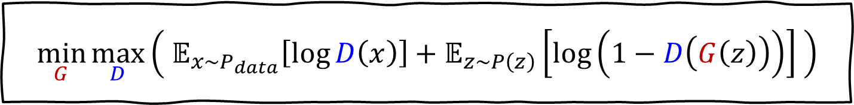
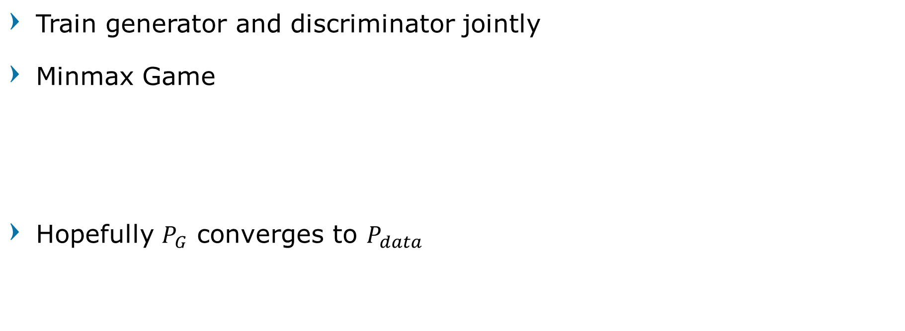
Training GANs: Two-player game
Train generator and discriminator jointly
Minmax Game
Hopefully $P_{G}$ converges to $P_{data}$
$$\min_{G}{\max_{D}\left( 𝔼_{x\sim P_{data}}\left[\log{D\left(x\right)}\right]+𝔼_{z\sim P\left(z\right)}\left[\log\left(1−D\left(G\left(z\right)\right)\right)\right] \right)}$$
Goodfellow et al, “Generative Adversarial Nets”, NIPS 2014
Computer Vision

Slide 12
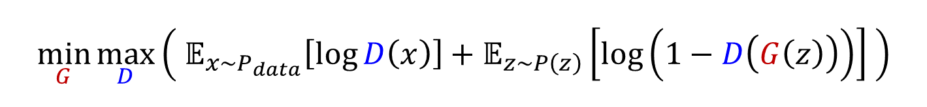
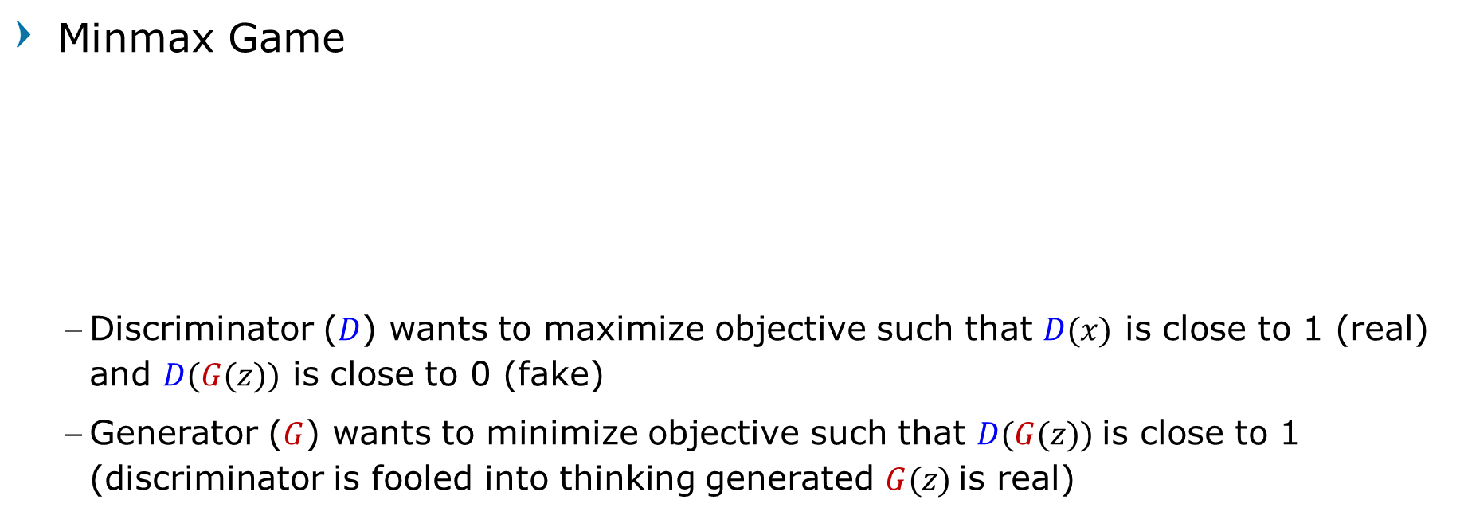
Training GANs: Two-player game
Minmax Game
Discriminator ($D$) wants to maximize objective such that $D(x)$ is close to 1 (real) and $D(G(z))$ is close to 0 (fake)
Generator ($G$) wants to minimize objective such that $D(G(z))$is close to 1 (discriminator is fooled into thinking generated $G(z)$is real)
$$\min_{G}{\max_{D}\left( 𝔼_{x\sim P_{data}}\left[\log{D\left(x\right)}\right]+𝔼_{z\sim P\left(z\right)}\left[\log\left(1−D\left(G\left(z\right)\right)\right)\right] \right)}$$
Goodfellow et al, “Generative Adversarial Nets”, NIPS 2014
Computer Vision

Slide 13
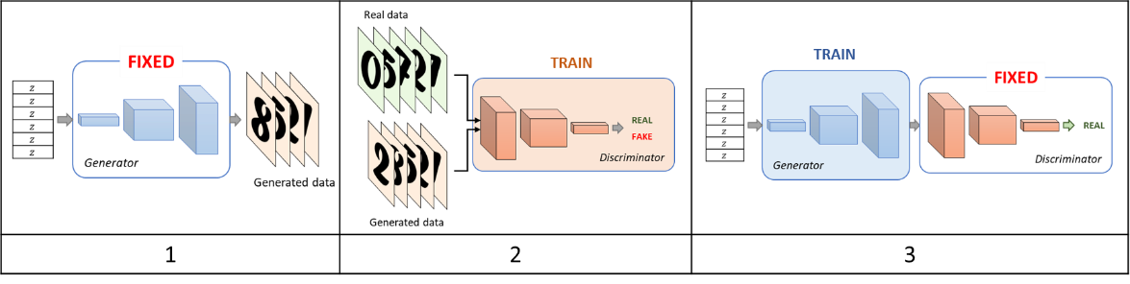
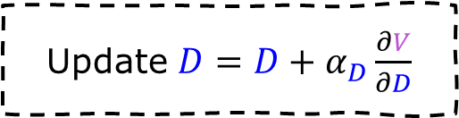
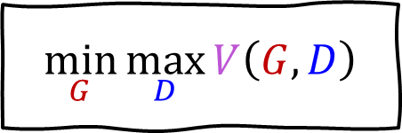
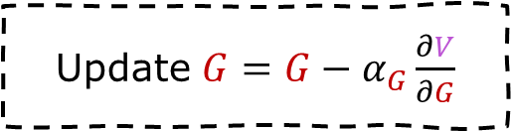
Generative Adversarial Networks
$$\min_{G}{\max_{D}{V\left(G,D\right)}}$$
Three steps process in alternating gradient updates
Update $D=D+α_{D}\frac{∂V}{∂D}$
Update $G=G−α_{G}\frac{∂V}{∂G}$
Computer Vision

Slide 14
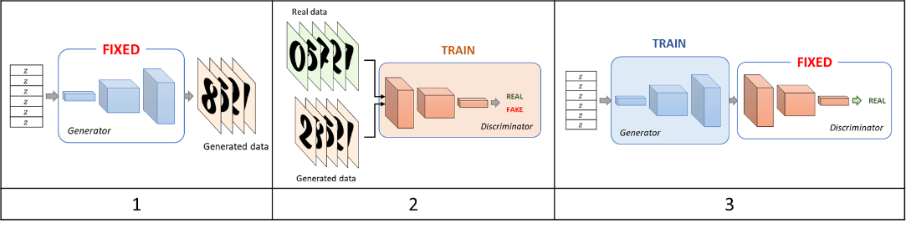

Generative Adversarial Networks
Three steps process in alternating gradient updates
We are not minimizing any overall loss!
No training curves to look at!
Computer Vision

Slide 15
Generative Adversarial Networks Intuition and Illustration
Computer Vision

Slide 16
Generative Adversarial Networks
Generator starts from noise to try to create an imitation of the data
Discriminator
Generator
Real Data
Fake Data
Computer Vision

Slide 17
Generative Adversarial Networks
Discriminator looks at both real data and fake data created by generator
Discriminator
Generator
Real Data
Fake Data
Computer Vision

Slide 18
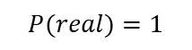
Generative Adversarial Networks
Discriminator tries to predict what’s real and what’s fake
Discriminator
Generator
$$P(real)=1$$
Real Data
Fake Data
Computer Vision

Slide 19
Generative Adversarial Networks
Discriminator tries to predict what’s real and what’s fake
Discriminator
Generator
$$P(real)=1$$
Real Data
Fake Data
Computer Vision

Slide 20
Generative Adversarial Networks
Discriminator tries to predict what’s real and what’s fake
Discriminator
Generator
$$P(real)=1$$
Real Data
Fake Data
Computer Vision

Slide 21
Generative Adversarial Networks
Discriminator tries to predict what’s real and what’s fake
Discriminator
Generator
$$P(real)=1$$
Real Data
Fake Data
Computer Vision

Slide 22
Generative Adversarial Networks
Generator tries to improve its imitation of the data
Discriminator
Generator
$$P(real)=1$$
Real Data
Fake Data
Computer Vision

Slide 23
Generative Adversarial Networks
Generator tries to improve its imitation of the data
Discriminator
Generator
$$P(real)=1$$
Real Data
Fake Data
Computer Vision

Slide 24
Generative Adversarial Networks
Discriminator tries to predict what’s real and what’s fake
Discriminator
Generator
$$P(real)=1$$
Real Data
Fake Data
Computer Vision

Slide 25
Generative Adversarial Networks
Discriminator tries to predict what’s real and what’s fake
Discriminator
Generator
$$P(real)=1$$
Real Data
Fake Data
Computer Vision

Slide 26
Generative Adversarial Networks
Discriminator tries to predict what’s real and what’s fake
Discriminator
Generator
$$P(real)=1$$
Real Data
Fake Data
Computer Vision

Slide 27
Generative Adversarial Networks
Discriminator tries to predict what’s real and what’s fake
Discriminator
Generator
$$P(real)=1$$
Real Data
Fake Data
Computer Vision

Slide 28
Generative Adversarial Networks
Generator tries to improve its imitation of the data
Discriminator
Generator
$$P(real)=1$$
Real Data
Fake Data
Computer Vision

Slide 29
Generative Adversarial Networks
Generator tries to improve its imitation of the data
Discriminator
Generator
$$P(real)=1$$
Real Data
Fake Data
Computer Vision

Slide 30

Generative Adversarial Networks
Until both of them converge (achieves its global minimum when $P_{G}=P_{data}$)
Discriminator
Generator
$$P(real)=1$$
Real Data
Fake Data
Computer Vision

Slide 31
After Training
Computer Vision

Slide 32
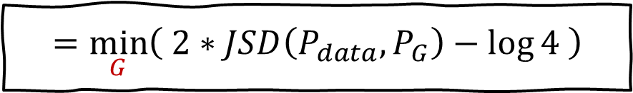
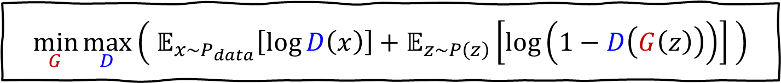
Generative Adversarial Networks
$$\min_{G}{\max_{D}\left( 𝔼_{x\sim P_{data}}\left[\log{D\left(x\right)}\right]+𝔼_{z\sim P\left(z\right)}\left[\log\left(1−D\left(G\left(z\right)\right)\right)\right] \right)}$$
Derive and simplify loss with Kullback-Leibler Divergence and Jensen-Shannon Divergence
$$=\min_{G}\left( 2∗JSD\left(P_{data},P_{G}\right)−\log{4} \right)$$
Computer Vision

Slide 33
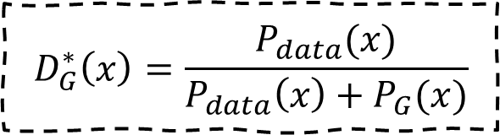
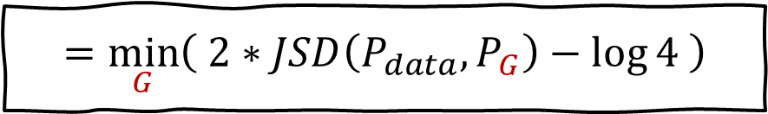
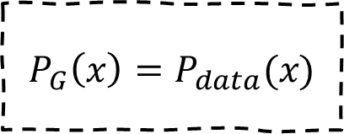
Generative Adversarial Networks
$$=\min_{G}\left( 2∗JSD\left(P_{data},P_{G}\right)−\log{4} \right)$$
The global minimum of the minimax game happens when:
Achieve optimal Discriminator for any G
Achieve optimal Generator for optimal D
$$D_{G}^{∗}\left(x\right)=\frac{P_{data}(x)}{P_{data}\left(x\right)+P_{G}(x)}$$
$$P_{G}\left(x\right)=P_{data}(x)$$
Computer Vision

Slide 34
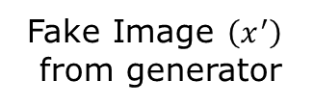
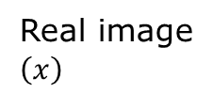
Generative Adversarial Networks: Testing
Real or Fake?
y
Discriminator Network (binary classification)
Fake Image $\left(x^{′}\right)$
from generator
Real image
$\left(x\right)$
Generator Network (decoder)
After training, use generator network to generate images
Random Noise
z
Goodfellow et al, “Generative Adversarial Nets”, NIPS 2014
Computer Vision

Slide 35
Generative Adversarial Networks: Results
Nearest neighbor from training set
Goodfellow et al, “Generative Adversarial Nets”, NIPS 2014
Computer Vision

Slide 36
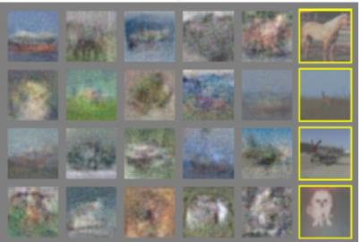
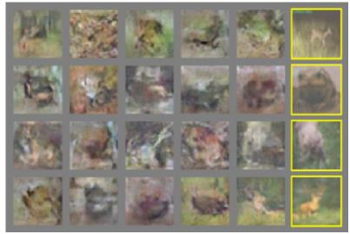
Generative Adversarial Networks: Results
Nearest neighbor from training set
Goodfellow et al, “Generative Adversarial Nets”, NIPS 2014
Computer Vision

Slide 37
Generative Adversarial Networks: DC-GAN
Radford et al, “Unsupervised Representation Learning with Deep Convolutional Generative Adversarial Networks”, ICLR 2016
Computer Vision

Slide 38
DC-GAN
Radford et al, “Unsupervised Representation Learning with Deep Convolutional Generative Adversarial Networks”, ICLR 2016
Computer Vision

Slide 39
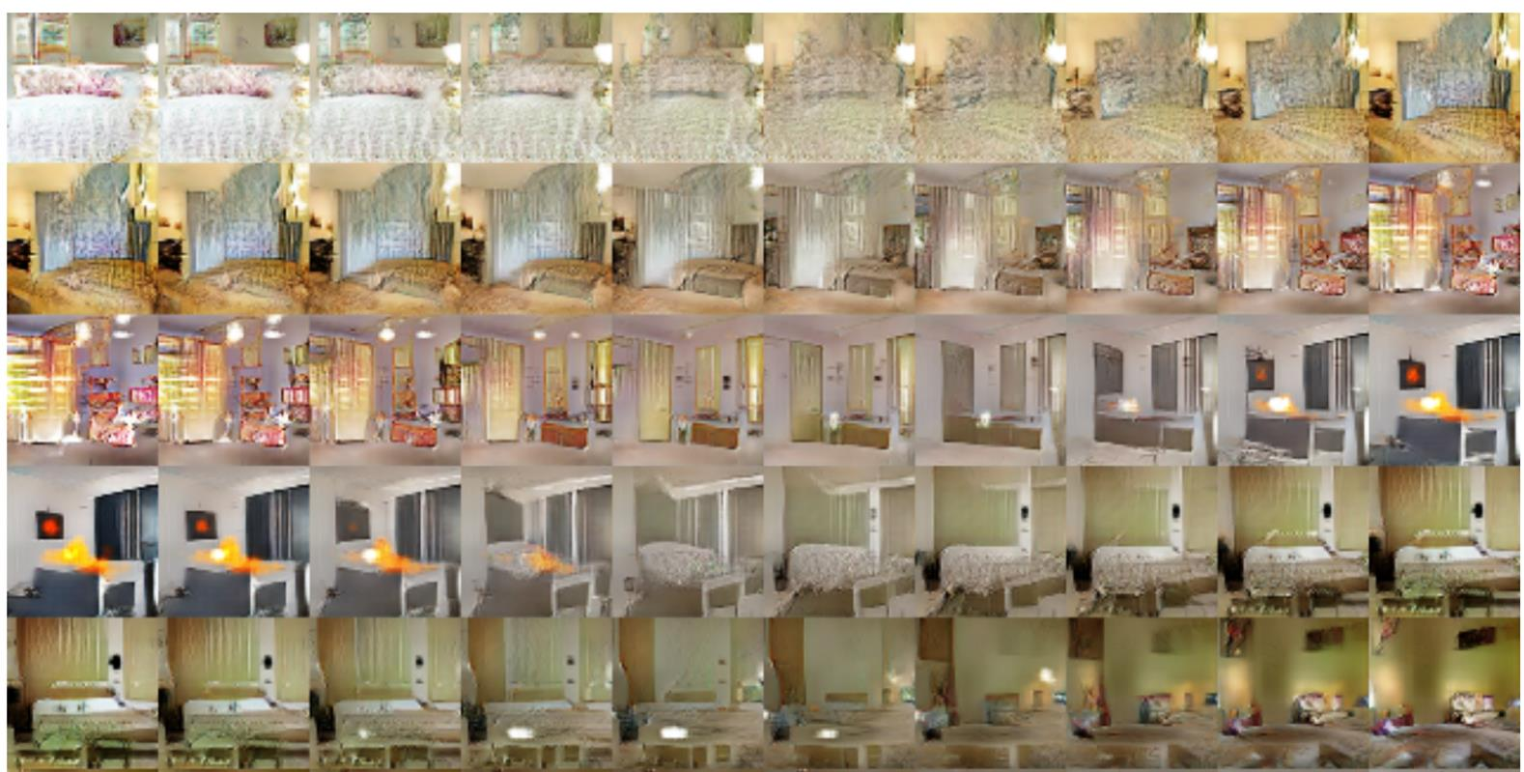
DC-GAN
Interpolating between random points in latent space
Radford et al, “Unsupervised Representation Learning with Deep Convolutional Generative Adversarial Networks”, ICLR 2016
Computer Vision

Slide 40
Interpretable Generative Adversarial Networks
Computer Vision

Slide 41
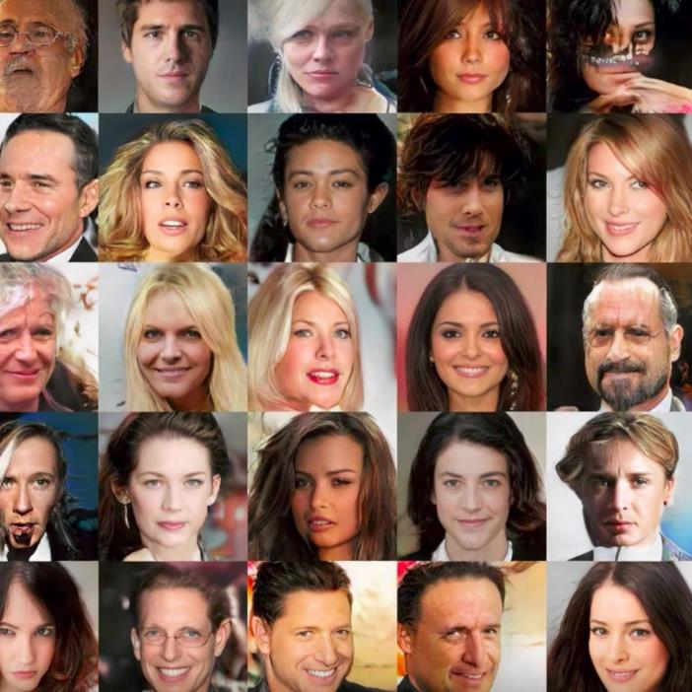
GANs: Interpretable Vector Math
Generate thousands of face images
Record the latent space
Classify and groups the images along with its latent space according to their class
Computer Vision

Slide 42
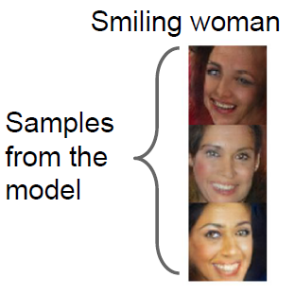
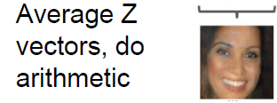
GANs: Interpretable Vector Math
For example, we collect latent space that produces an image of "smiling woman"
If we average the latent space,
the new vector average of latent space will still produce images of "smiling women"
Radford et al, “Unsupervised Representation Learning with Deep Convolutional Generative Adversarial Networks”, ICLR 2016
Computer Vision

Slide 43
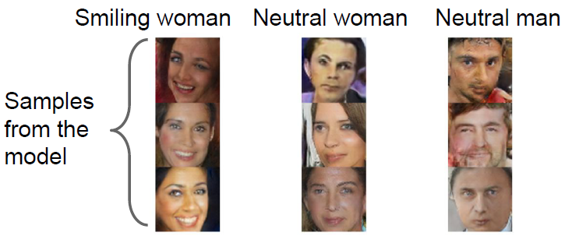
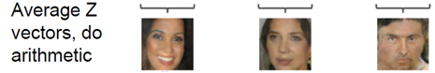
GANs: Interpretable Vector Math
Radford et al, “Unsupervised Representation Learning with Deep Convolutional Generative Adversarial Networks”, ICLR 2016
Computer Vision
Notes:
Interpolating
between
random
points in latent
space

Slide 44
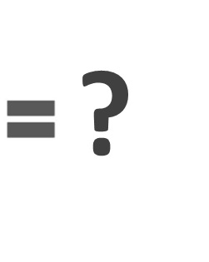


GANs: Interpretable Vector Math
Radford et al, “Unsupervised Representation Learning with Deep Convolutional Generative Adversarial Networks”, ICLR 2016
Computer Vision
Notes:
Interpolating
between
random
points in latent
space

Slide 45
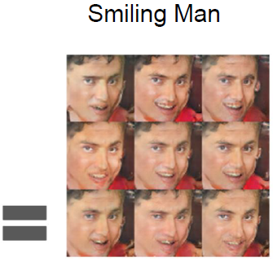
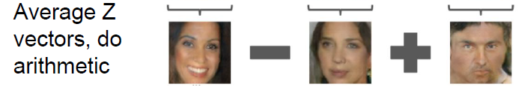
GANs: Interpretable Vector Math
Radford et al, “Unsupervised Representation Learning with Deep Convolutional Generative Adversarial Networks”, ICLR 2016
Computer Vision
Notes:
Interpolating
between
random
points in latent
space

Slide 46
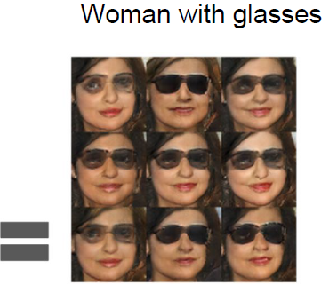
GANs: Interpretable Vector Math
Radford et al, “Unsupervised Representation Learning with Deep Convolutional Generative Adversarial Networks”, ICLR 2016
Computer Vision
Notes:
Interpolating
between
random
points in latent
space

Slide 47
2017: The Year of Generative Adversarial Networks
Computer Vision

Slide 48
2017: Year of the GAN
https://github.com/hindupuravinash/the-gan-zoo
Computer Vision

Slide 49
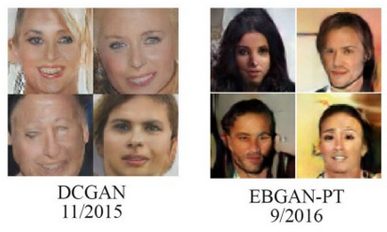
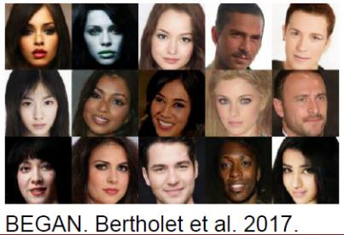
2016s’ GAN 2017s’ GAN
Computer Vision

Slide 50
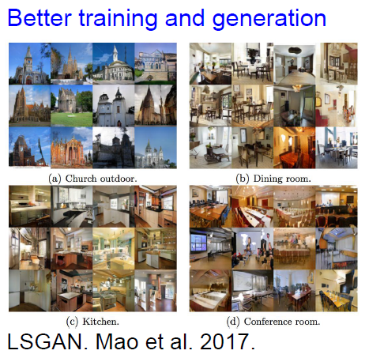
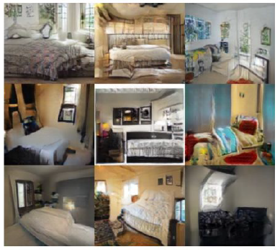
2017: Year of the GAN
Zhu 2017
Computer Vision

Slide 51
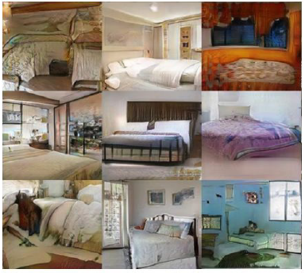
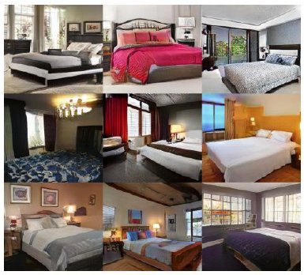
2017s’ GANs
Wasserstein GAN, Arjovsky 2017.
Improved Wasserstein GAN, Gulrajani 2017
Computer Vision

Slide 52
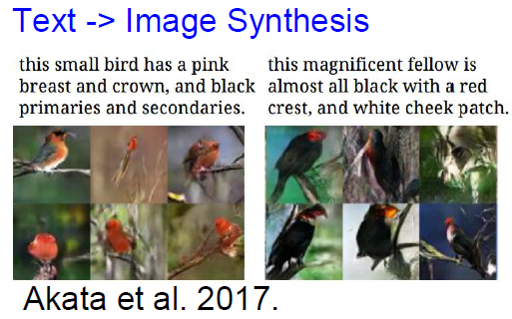
2017s’ GANs
Computer Vision

Slide 53
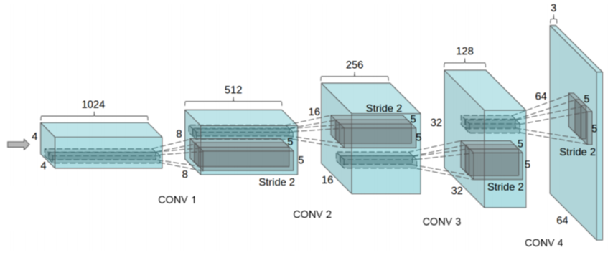


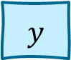
2017: Conditional GANs
Recall: Conditional Generative Models learn $p(x|y)$ instead of $p(x)$
Make generator and discriminator both take label $y$ as an additional input!
$$z$$
$$y$$
Computer Vision

Slide 54
2017: Conditional GANs - Spectral Normalization
Miyato et al, “Spectral Normalization for Generative Adversarial Networks”, ICLR 2018
Computer Vision

Slide 55
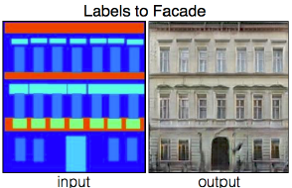
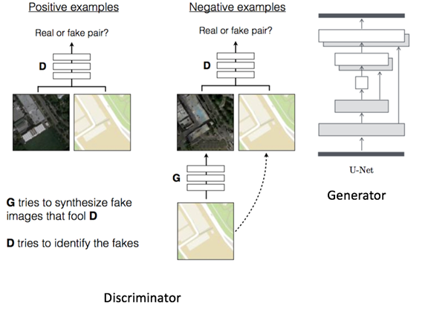
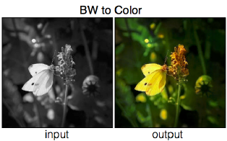
2017: Pix2Pix
Isola et al, “Image-to-Image Translation with Conditional Adversarial Networks”, CVPR 2017
Computer Vision

Slide 56
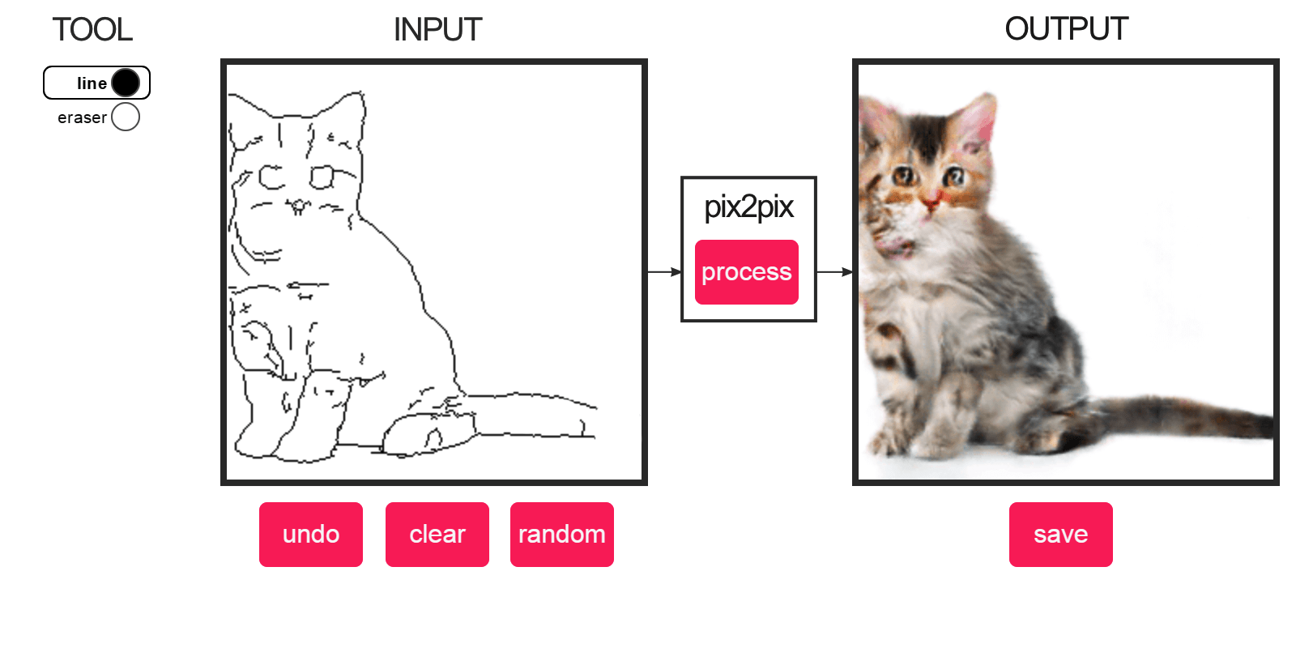


2017: Pix2Pix
Isola et al, “Image-to-Image Translation with Conditional Adversarial Networks”, CVPR 2017
Computer Vision

Slide 57

2017: CycleGAN
Zhu et al, “Unpaired Image-to-Image Translation using Cycle-Consistent Adversarial Networks”, ICCV 2017
Computer Vision

Slide 58



2017: CycleGAN
Source → Target Domain transfer
Zhu et al, “Unpaired Image-to-Image Translation using Cycle-Consistent Adversarial Networks”, ICCV 2017
Computer Vision

Slide 59


2017: CycleGAN
Source → Target Domain transfer
Zhu et al, “Unpaired Image-to-Image Translation using Cycle-Consistent Adversarial Networks”, ICCV 2017
Computer Vision

Slide 60
2017: Image Super Resolution
Ledig et al, “Photo-Realistic Single Image Super-Resolution Using a Generative Adversarial Network”, CVPR 2017
Computer Vision

Slide 61
2018s’ GANs
Computer Vision

Slide 62

2016-2018
Computer Vision

Slide 63
2018: BigGAN
Brock et al, “Large Scale GAN Training for High Fidelity Natural Image Synthesis”, ICLR 2019
Computer Vision

Slide 64

2018: Progressive GAN
Karras et al, “Progressive Growing of GANs for Improved Quality, Stability, and Variation”, ICLR 2018
Computer Vision

Slide 65

2018: Conditional GANs - Self-Attention
Zhang et al, “Self-Attention Generative Adversarial Networks”, ICML 2019
Computer Vision

Slide 66

2018: StarGAN
Computer Vision

Slide 67

Computer Vision

Slide 68

Computer Vision

Slide 69

2018: Pose Guided Person Image Generation
Computer Vision

Slide 70

2018: Image Inpainting
Computer Vision

Slide 71

2018: GAUGAN - Label Map to Image
Park et al, “Semantic Image Synthesis with Spatially-Adaptive Normalization”, CVPR 2019
Computer Vision

Slide 72

2018: GAUGAN
Park et al, “Semantic Image Synthesis with Spatially-Adaptive Normalization”, CVPR 2019
Computer Vision

Slide 73

2018: Text to Image
Zhang et al, “StackGAN++: Realistic Image Synthesis with Stacked Generative Adversarial Networks.”, TPAMI 2018
Zhang et al, “StackGAN: Text to Photo-realistic Image Synthesis with Stacked Generative Adversarial Networks.”, ICCV 2017
Computer Vision

Slide 74
2019-2020s’ GANs
Computer Vision

Slide 75
2019: StyleGAN
Karras et al, “A Style-Based Generator Architecture for Generative Adversarial Networks”, CVPR 2019
Computer Vision

Slide 76


2019: StyleGAN
Karras et al, “A Style-Based Generator Architecture for Generative Adversarial Networks”, CVPR 2019
Computer Vision

Slide 77

2019: Adversarial Video Generation
Clark et al, “Adversarial Video Generation on Complex Datasets”, arXiv 2019
Computer Vision

Slide 78
Current State-of-the-Art: StyleGAN2
Karras et al, “Analyzing and Improving the Image Quality of StyleGAN”, CVPR 2020
Computer Vision

Slide 79


DeepFake
Computer Vision

Slide 80
Summary
Don’t work with an explicit density function
Take game-theoretic approach:
learn to generate from training distribution through 2-player game
Computer Vision

Slide 81
Summary
Pros:
Beautiful, state-of-the-art samples!
Cons:
Trickier / more unstable to train
Can’t solve inference queries such as p(x), p(z|x)
Computer Vision

Slide 82
Summary
Active areas of research:
Better loss functions, more stable training (Wasserstein GAN, LSGAN, many others)
Conditional GANs, GANs for all kinds of applications
Computer Vision

Slide 83

Question?
Computer Vision

Slide 84

Next Agenda
Localization and Detection
Computer Vision

Slide 85
References
Fei-Fei Li, Andrej K, Justin J - Stanford CS231n 2016 Course
Fei-Fei Li, Justin J, Serena Y - Stanford CS231n 2018 Course
Justin Johnson– EECS498 Lectures, University of Michigan
Grauman, K. and Leibe, B. 2011. Visual Object Recognition. Synthesis Lectures Artif. Intell. Mach. Learn. 5, 1 181
Computer Vision

